Slide 1
Air Bearing Autobalancer
Dmitriy Rivkin

Slide 2
Objective
Automated balancing of air bearing with minimal human involvement
Balancing means center of gravity is co-located with center of rotation, eliminating torque due to gravity

Slide 3
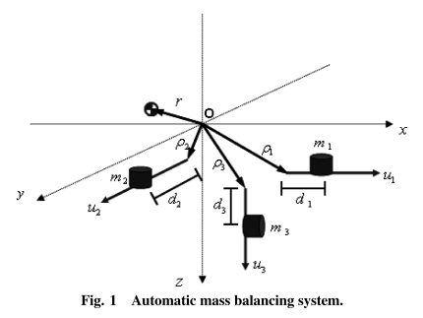
Basics
Balancing is achieved using three linearly translating motorized masses
Notes:
Kim and Agrawal

Slide 4
Basics
Balancing happens offline
Weights not being adjusted during sat testing
Rebalance between tests
Coarse adjustments are manual
Allows smaller sliding weights, increased precision
Battery powered

Slide 5
Balancing Approaches
Batch estimation
Develop equations of motion
Actuate system (with reaction wheels)
Use some (least squares) approach to find best estimate of CoG
Once CoG is known, move masses to compensate
Sensitive to knowledge of actuator parameters
Multiple iterations needed
Requires IMU
Requires actuation

Slide 6
Balancing Approaches
Alternative Approach to Batch Estimation
Move masses
Measure change of equilibrium position
Compute center of mass
Move masses to compensate

Slide 7
Balancing Approaches
Feedback approach
Apply impulse(s)
While system is spinning, apply feedback control law to drive external torque to zero
Implemented by Kim and Agrawal
Requires knowledge of initial MOI
Requires IMU
Requires actuation

Slide 8
Old School Manual Balancing Technique

